Slide 1
How to Redesign a 19-Year-old Legacy Application
June 7, 2022
Using Agile and User Experience Methodologies
UX Summit 2022

Slide 2
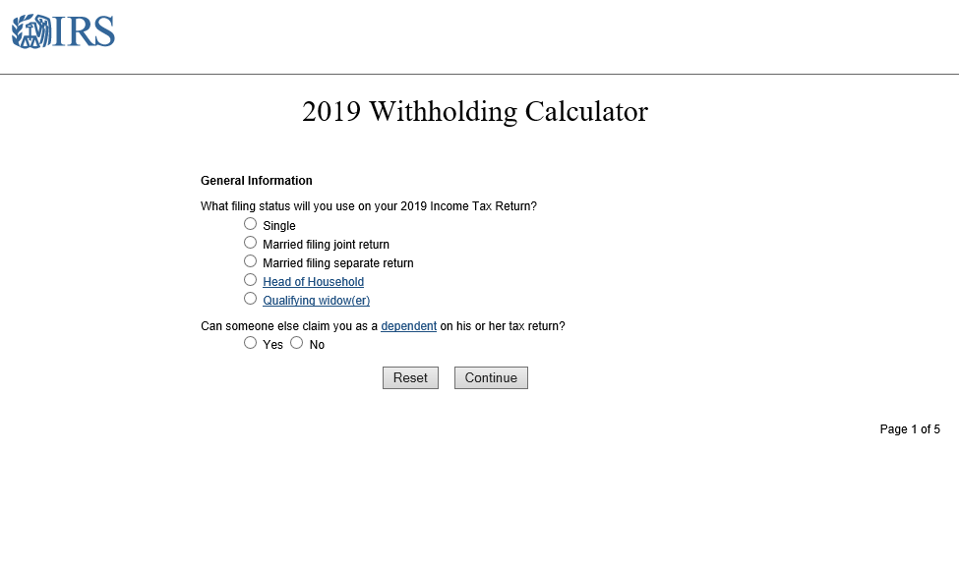
How it started…

Slide 3
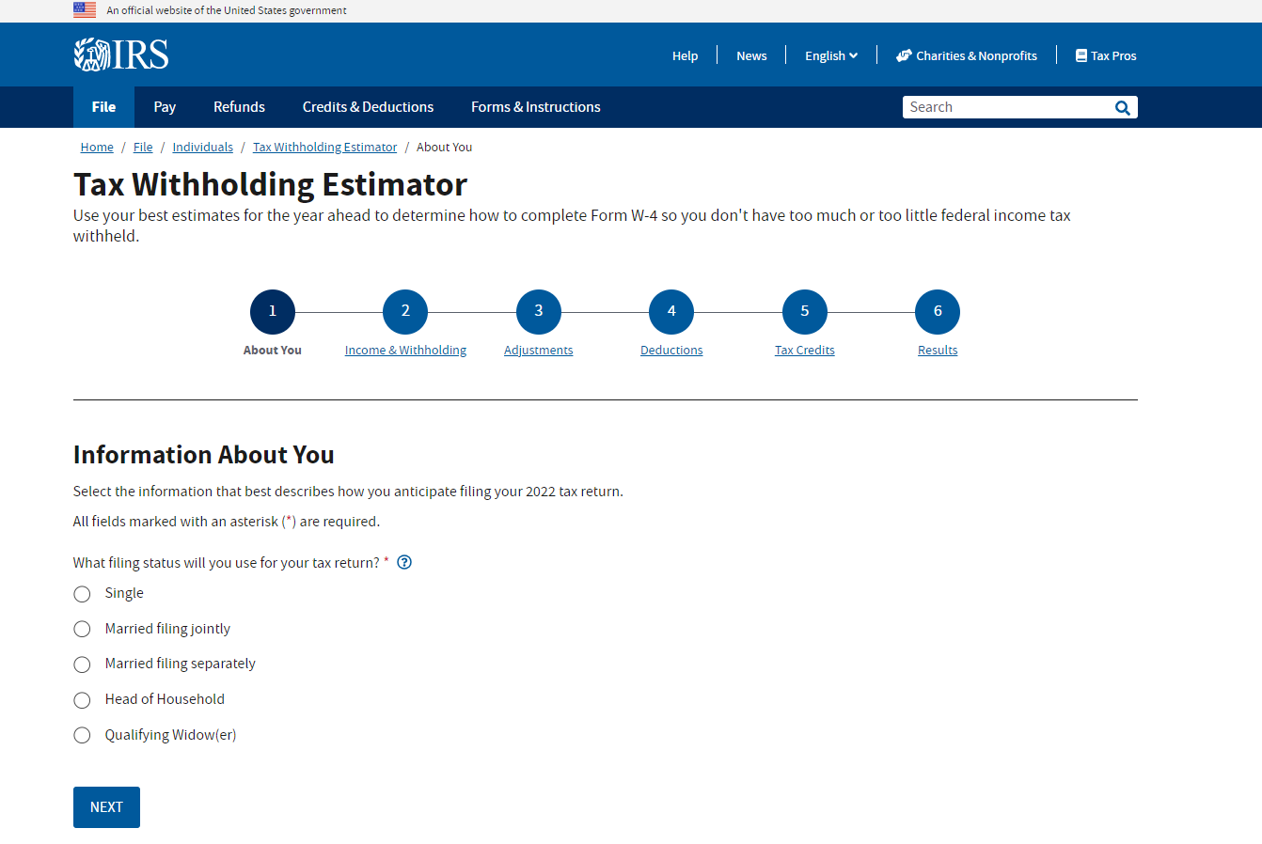
How it’s going…

Slide 4
And NO, we are NOT waiting 19 years to update this application again

Slide 5
At the end of this session, you will:
Know the story behind this project
Know the user experience and Agile processes used
Know more about the evolution of the application
Have some tips and tricks you can use on your next project

Slide 6
How it started

Slide 7
This project started in 1999
1999
The original Withholding Calculator application was created.
2017
Online Services reviewed all IRS.gov web applications and recommended rebuilding the Withholding Calculator.
2018
Our UXD team conducted foundational research in preparation for the redesign efforts.

Slide 8
But the change truly began in 2019
2019
IRS Online Services officially kicked off this redesign in April.
2020
We launched the new Tax Withholding Estimator in August.
The team – fully remote due to the pandemic – continued to update the application.

Slide 9
And the changes continue today
2021
The team improved the logic in Steps 1 and 2 based on user feedback and data.
2022
We launched the application in Spanish.
We’ll test more changes in early Summer.

Slide 10
It’s all about the iterative process

Slide 11
Research and design help the IRS conceptualize ideas
^{Foundation}
^{Exploration}
^{Execution}
^{Measurement}
Identify Opportunities
Design the Right Products
Build the Products Right
Learn how Customers Use the Products
Who are our users?
What do they need to succeed?
What solutions will better meet customer needs?
How do these solutions align with business goals?
How should the IRS design and deliver a complete experience?
What enhancements could the IRS make to improve customer experience?

Slide 12
We use an iterative design approach
Using this iterative design process for the Tax Withholding Estimator, we will create the best experience for the public:
Identify a need
Elaborate and brainstorm to create a solution that follows UX best practices
Test the app with real users
Have a “refine” approach
Test again
Repeat as necessary
Update the application with continuous analytics and feedback from app-specific survey and user testing
Elaboration
User Test
Refine
User Test
Build
Refine
User Test

Slide 13
Agile development was critical to our success
Our process has adopted Agile principles from start to finish, developing a product faster with fewer headaches.
Without the Agile method, we wouldn’t have been able to update this application as much as we have in the past 3 years.
Plan
Design
Build
Test
Review

Slide 14
Always keep the main goal in mind
The public would like a user-friendly tool to help them understand how to fill out a Form W-4 to make sure they don’t have too much, or too little federal income tax withheld from their pay.

Slide 15


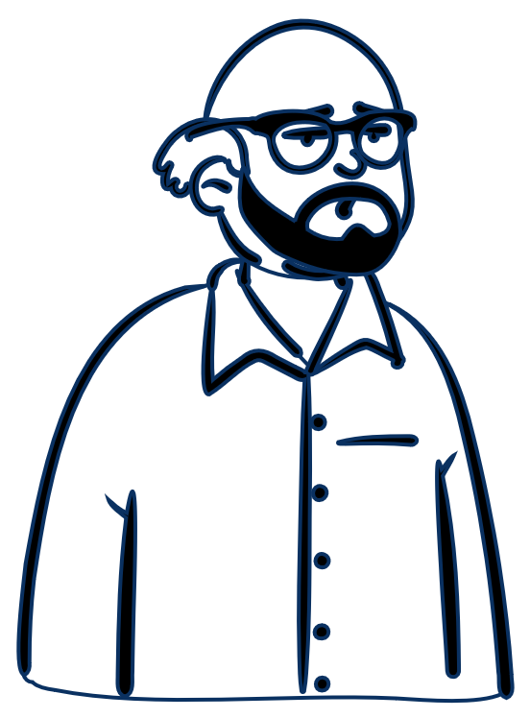
And more importantly, keep the end-user in mind
The team used 3 personas, who represent most of the people using the application, to prioritize research and backlog items that serve users better.
Frank
Simple routine filer
Leslie
First-time filer
George
Multiple part-time job filer
Notes:
Images source: Microsoft PowerPoint stock images.

Slide 16
How it’s going

Slide 17
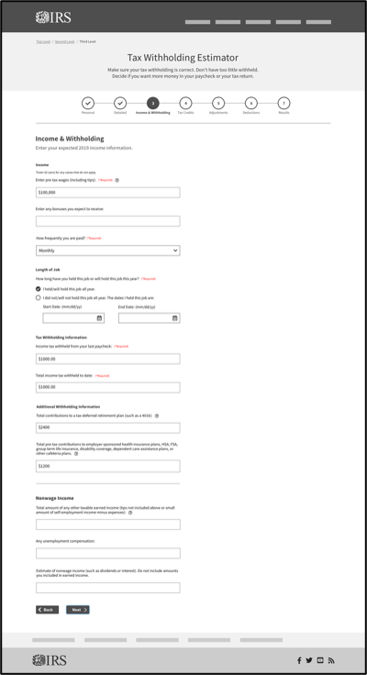
We started with a low-fidelity concept
We used user research findings and recommendations to create these concepts for the 2019 elaboration session.
The subject matter experts and the development team gave feedback and insights based on expertise and technological applications unknown to UXD.

Slide 18
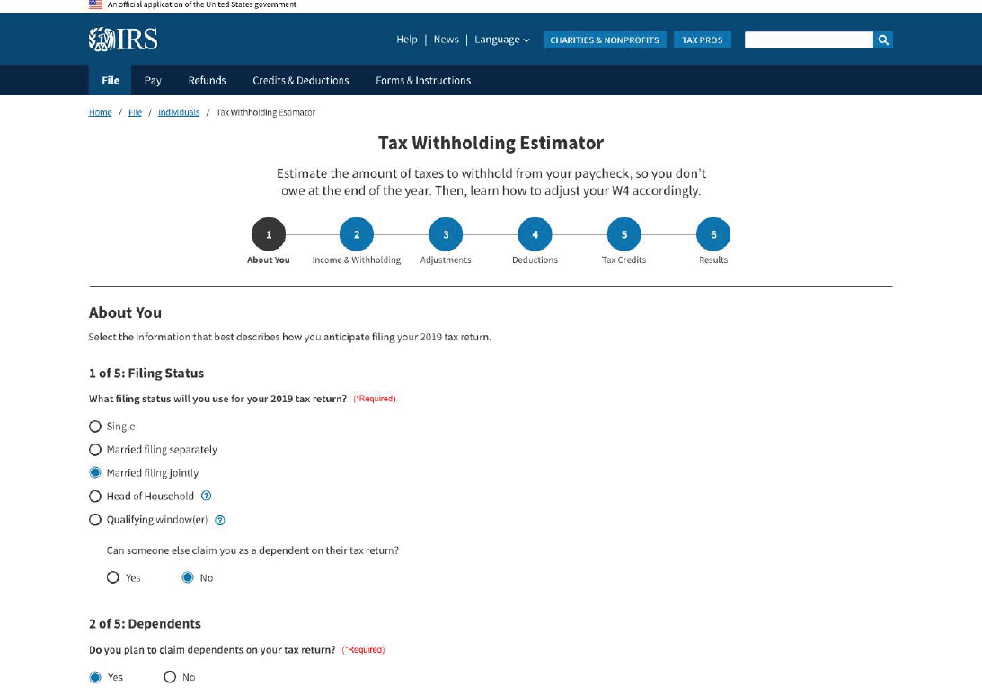
We then moved to high-fidelity concepts
Original Withholding Calculator (2019)
New Tax Withholding Estimator (2019 concept)
¹
²
³
⁴
⁵

Slide 19
2019 concept
¹
²
³
⁴
⁵

Slide 20
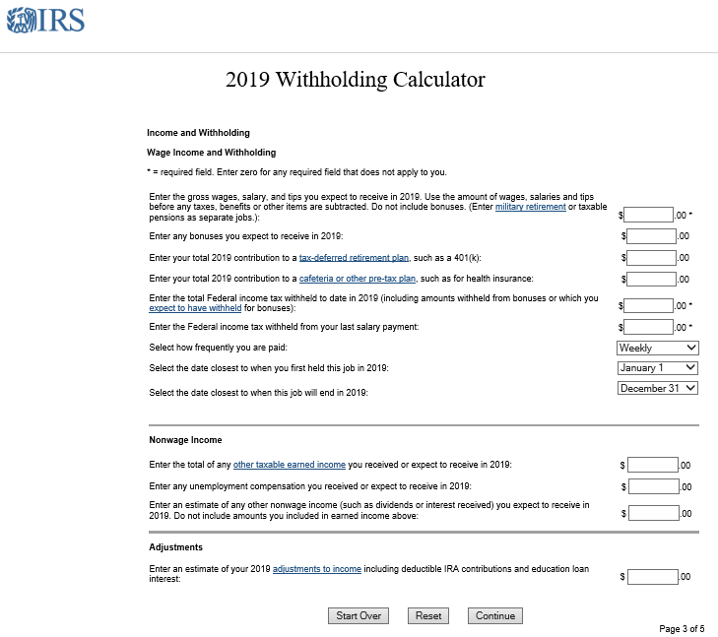
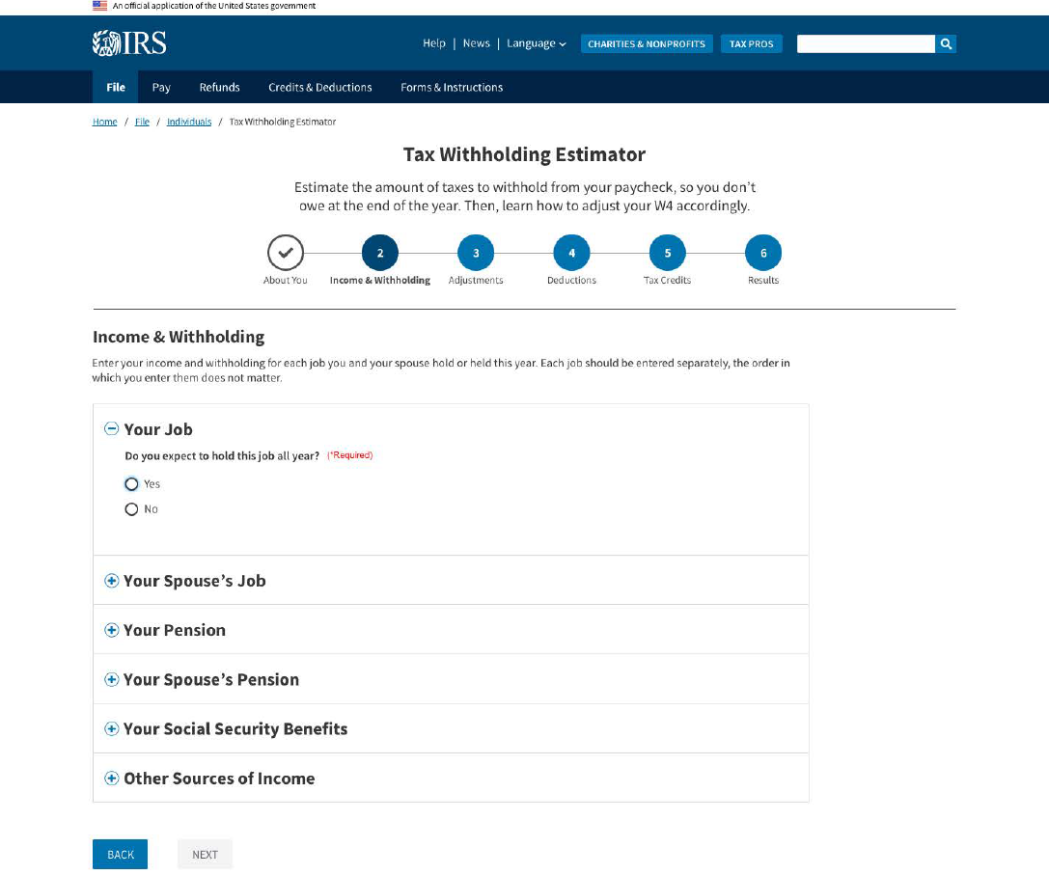
We updated the “Income & Withholding” step
Original Withholding Calculator (2019)
New Tax Withholding Estimator (2019)
²
³
¹
²

Slide 21
2019 “Income & Withholding” step
²
³
¹
²

Slide 22
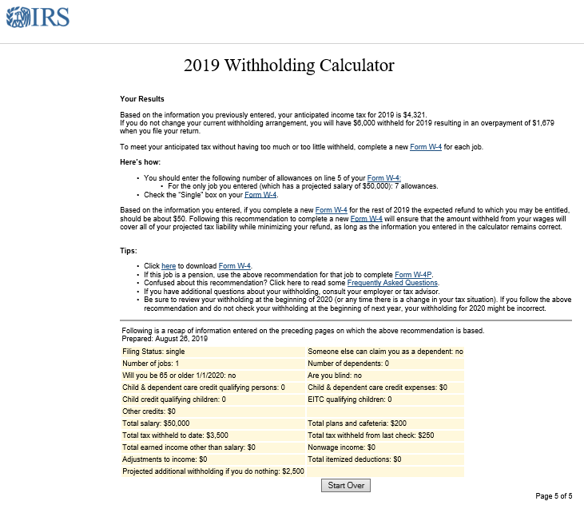
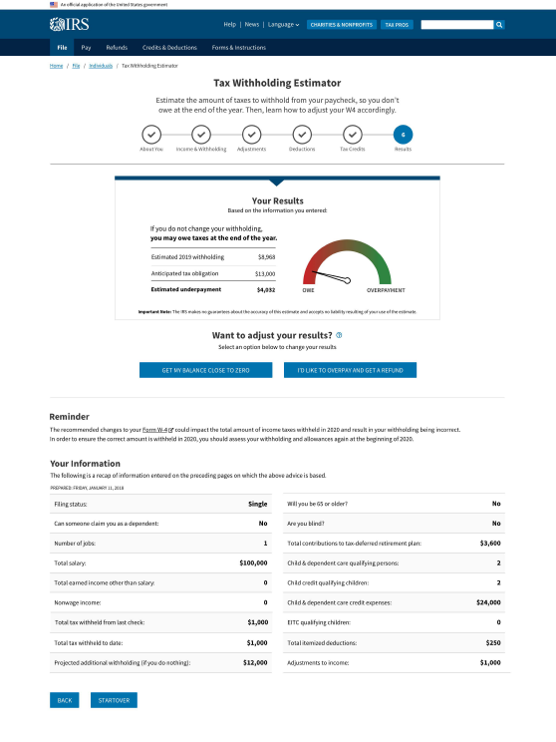
And we improved the “Results” page
Original Withholding Calculator (2019)
New Tax Withholding Estimator (2019)
¹
²
³

Slide 23
2019 “Results” page
¹
²
³

Slide 24
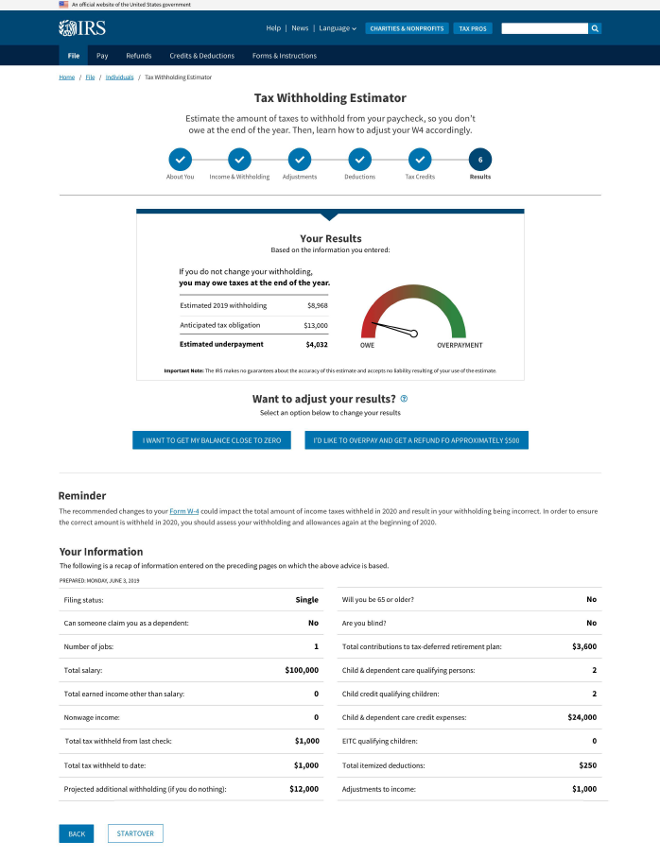
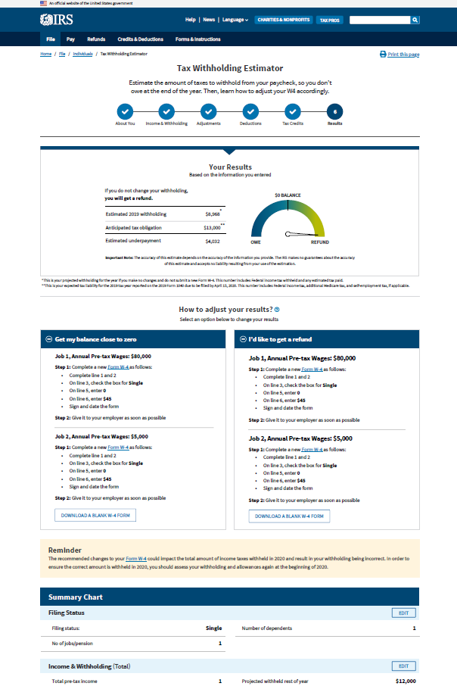
But that wasn’t the only “Results” page we designed
2nd iteration (July 2019)
3rd iteration (August 2019)
¹
¹
²
²
³
³

Slide 25
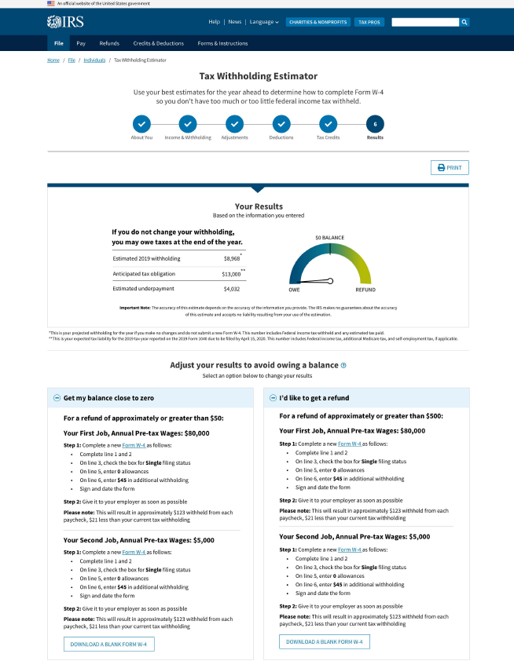
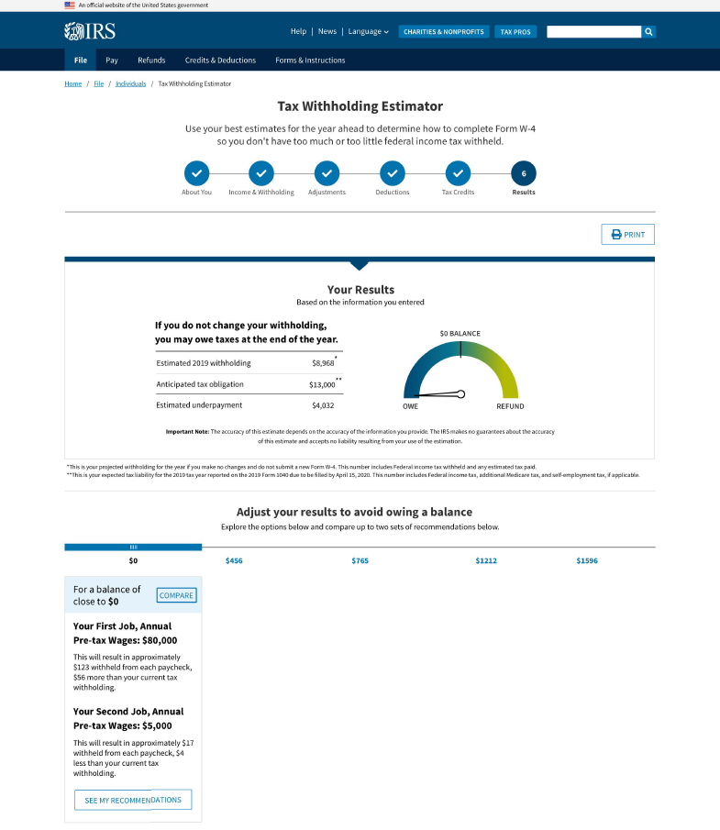
User feedback was key to make changes to this page
4th iteration (September 2019)
5th iteration (October 2019)
¹
²
¹
²

Slide 26
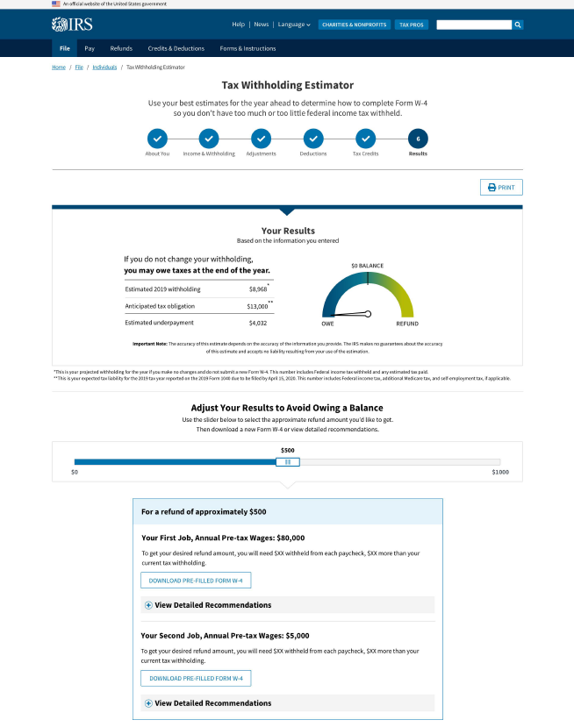
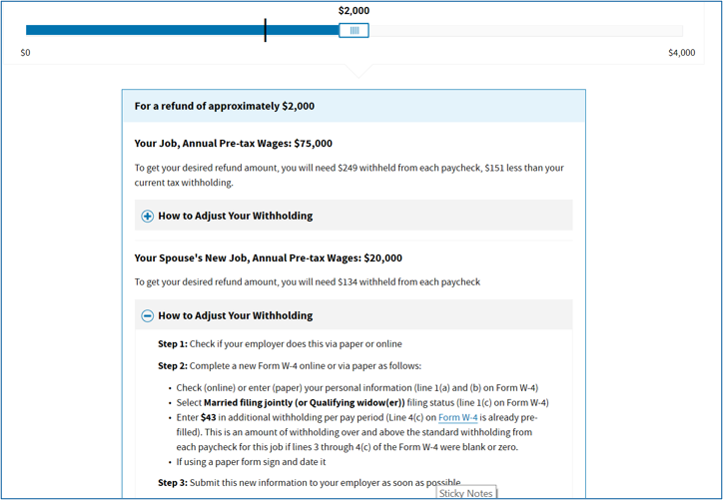
We were determined to keep making this page better
6th iteration (launched Dec 2019)
7th iteration (launched July 2020)
¹
¹

Slide 27
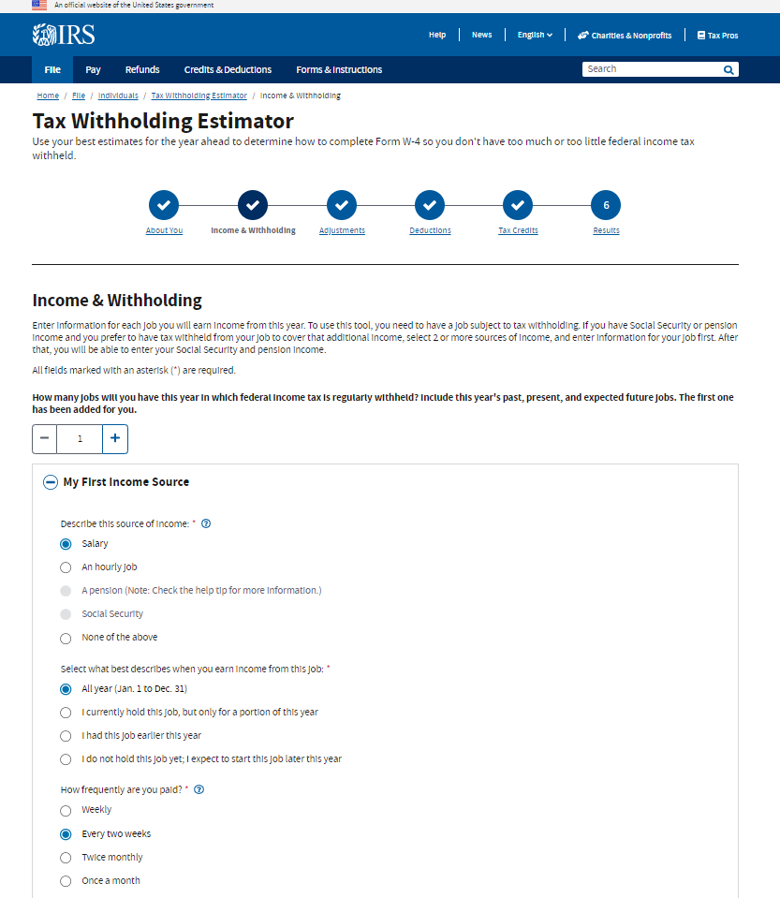
We improved the logic in Steps 1 and 2
Step 2 (Launched in 2019)
Step 2 (Launched in 2021)
¹
²
³

Slide 28
2021 Step 2
¹
²
³

Slide 29
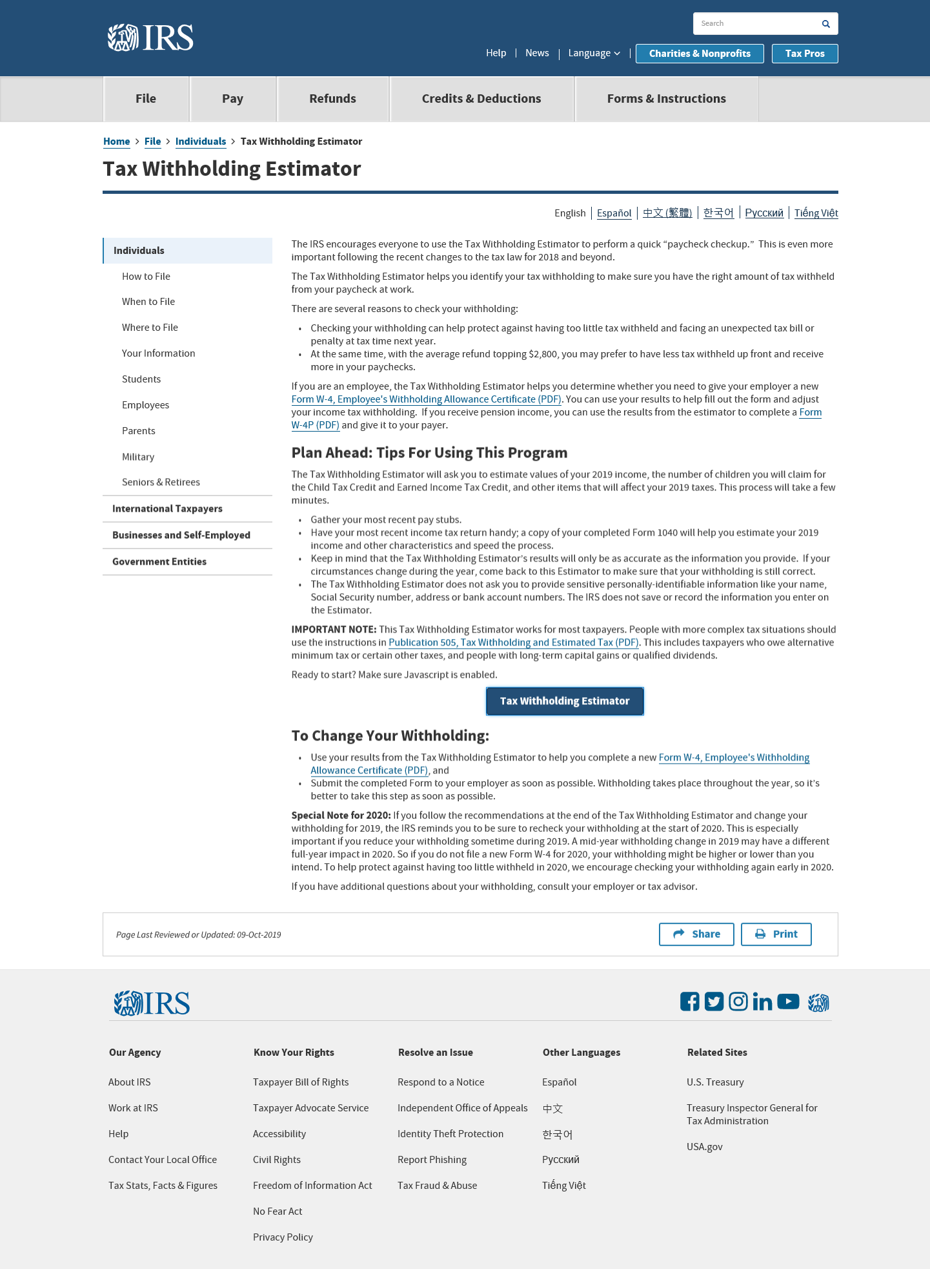
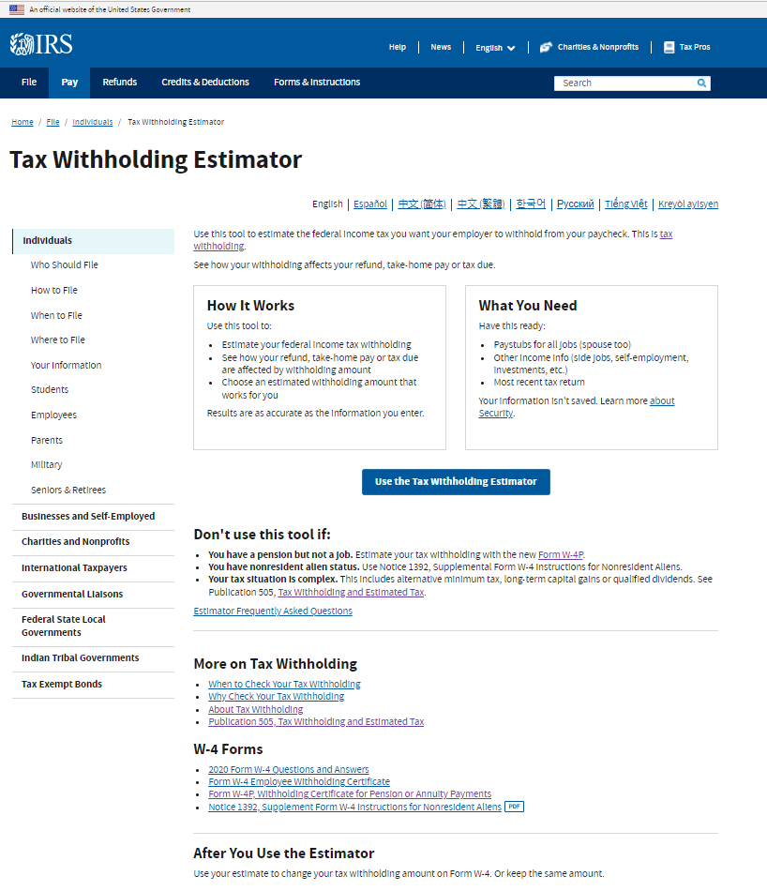
We also redesigned the landing page on IRS.gov
Application landing page (2019)
Application landing page (2022)
¹
²
³

Slide 30
2022 Application landing page
¹
²
³

Slide 31
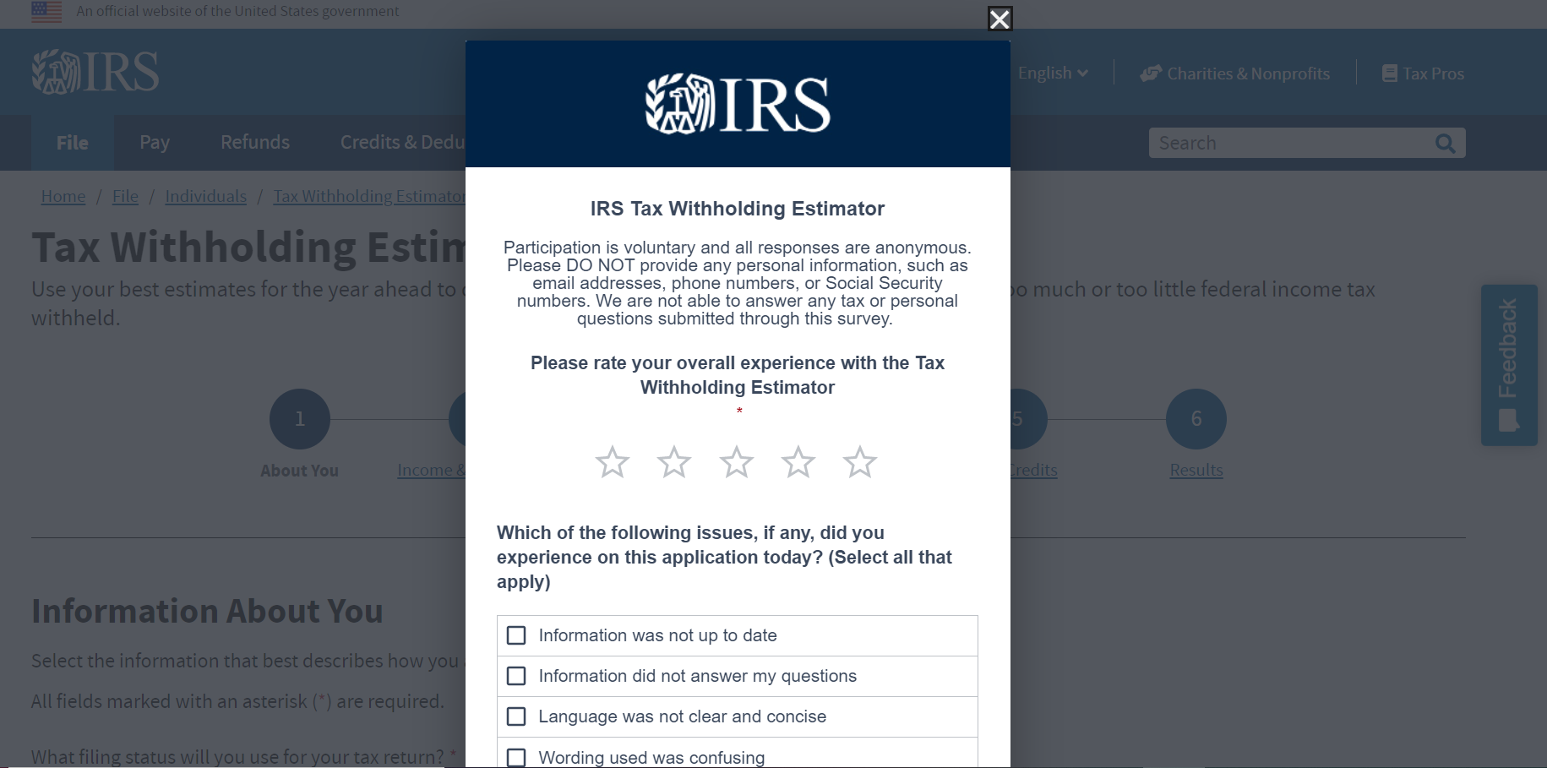
The changes to the application are all based on data
The team regularly reviews both app-specific user feedback and IRS.gov user feedback for the Tax Withholding Estimator.
We use this feedback to:
Create user stories
Prioritize product backlog
Inform FAQ page content

Slide 32
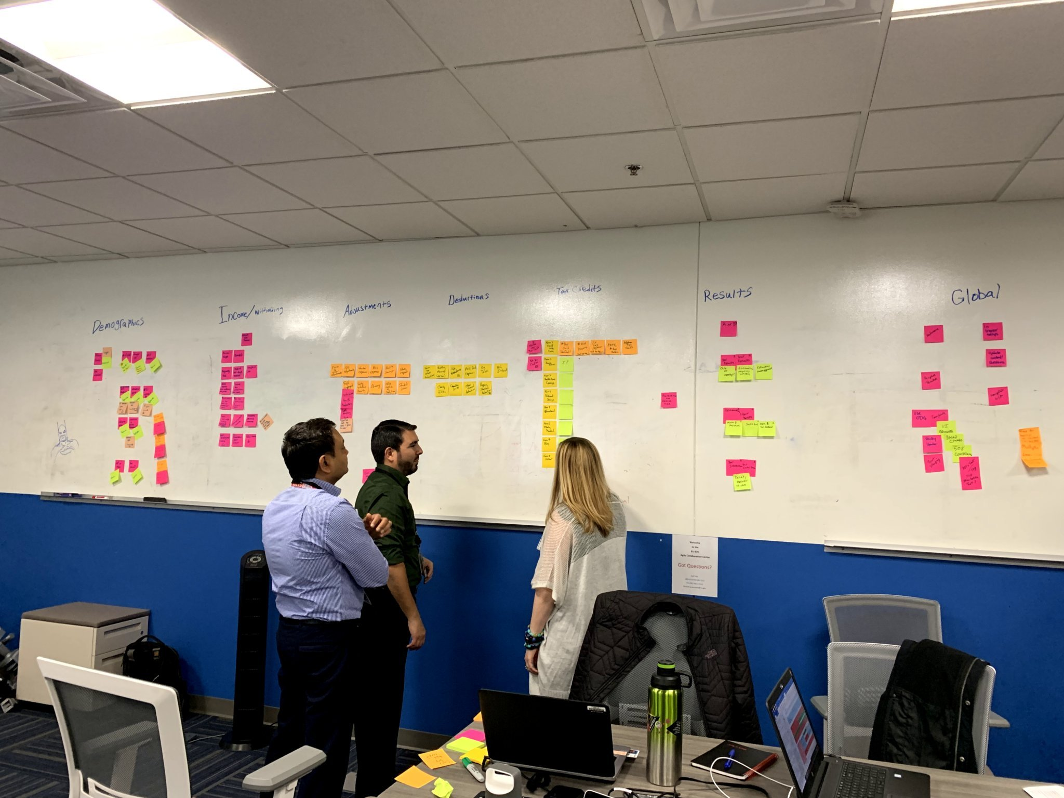
And we went from in-person sessions…

Slide 33
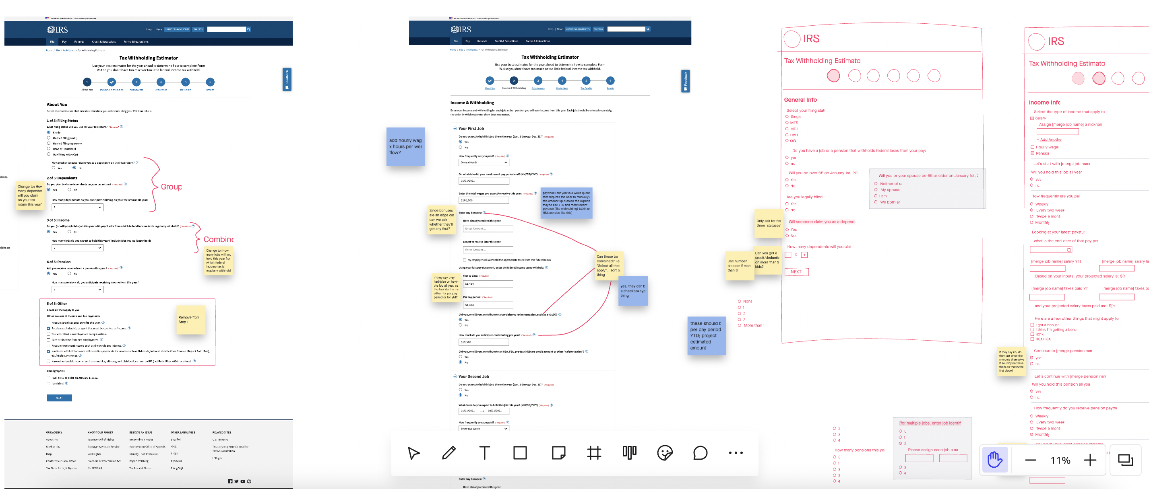
To virtual sessions…

Slide 34
This experience taught us so much

Slide 35
We have a recipe for success
Engage with the business owner of the legacy application early on
Understand that some stakeholders may not be familiar with Agile and UXD methodologies
Prioritize communication among all team members
Have an agenda for every team meeting to stay on track with deliverables and send a summary after each meeting
Review application content – because the words matter as much as the design
Include a feedback button on every page of your application, not just on your results page

Slide 36
We know it takes a village to build an application
Meet with the leadership team monthly to show them your progress and gather their feedback
Include the Section 508 and Web Content Accessibility Guidelines experts from the beginning
Involve the development team in the design process
Organize elaboration sessions at the beginning of each major phase of your project

Slide 37
And we follow these rules conscientiously
Test, test, test and test. Don’t launch something to the public that is not supported by user research and data
You’re not the user of your application. Use personas to help you design an app for your target audience
Use quotes from user testing sessions. Listen to real people telling you their experience to help you sell your story better
Don’t assume the first launch is the last launch
And lastly… Don’t be afraid to redesign a legacy application

Slide 38
Now that you know how we did it, check out the application yourself and give us your feedback: Link to the Tax Withholding Estimator

Slide 39
Thank you for joining us today! Sam Chapman Samuel.L.Chapman@irs.gov Kira Prin Kira.Prin@irs.gov

